Slide 1
Project Meeting
IoT Group_2019.05.17

Slide 2
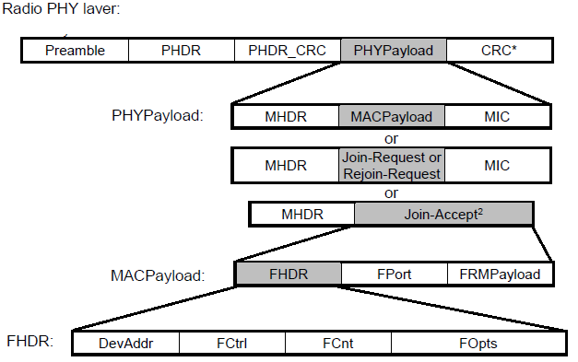
Performance of Raspberry pi execution
Packet: 267 bytes * 200
Buffer size: at least 53400 bytes
7-255
8
2
4bit
7-255
2
Bytes
1
7-M
4
7-22
0-1
0-N

Slide 3
Buffer design
Buffer in python
bytearray

